Slide 1
Brewery Market Study
Rikel Djoko & Ben Tanaka

Slide 2
Problem statement
We are trying to enter to a new brewery market, but we don’t know what component or factor make a most profitable beer

Slide 3
Approach
We conduct a research where we analyze data on a large number of beers and breweries. The Beers dataset contains a list of 2410 US craft beers and Breweries dataset contains 558 US breweries. The datasets descriptions are as follows.

Slide 4
Data Analysis
Colorado and California have the most breweries compared to all other states. Colorado has the most breweries with 47 total breweries which is 8 more than California.

Slide 5
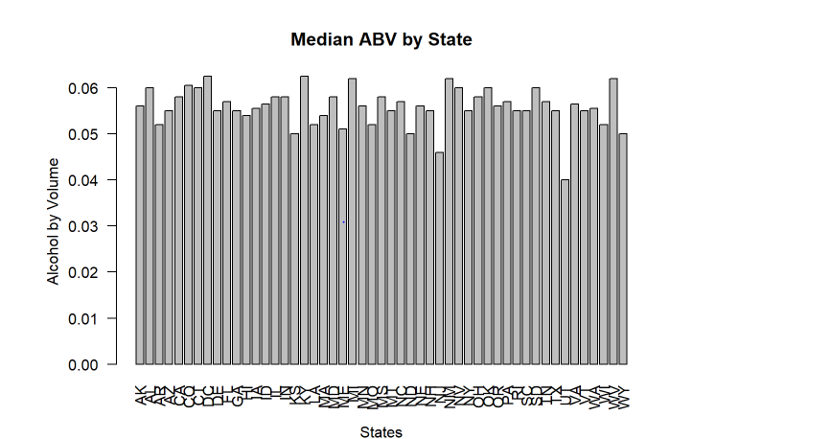
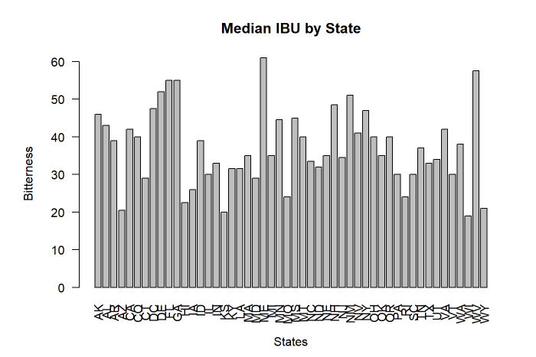
Alcohol content and bitterness
The median alcohol content was calculated to be 0.056 with a maximum of 0.128 and mean of 0.059.
The median bitterness unit was calculated to be 35 with a maximum of 138 and mean of 42.71.
The beer alcohol content doesn’t vary much but can have some wide ranges. This could be based on laws which prohibit the sale of extreme beers. Whereas the bitterness does have variation which could defer to the overall taste that brew master wishes the beer to taste like.

Slide 6
Relationship between alcohol content and bitterness of beer
It appears that the more alcohol that is contained beer the more variation of the bitterness of the beer is developed. Whereas when the alcohol content is lower the bitterness seems to cluster.

Slide 7
Conclusion
Looking at the correlation between the two main factors : bitterness and alcoholic content , it doesn’t seems to be a strong relationship between the two with Simple regression Coefficient of Adjusted R-squared: 0.4493 .

